Slide 1

Fake News Detection on Social Media Tianyi Xiong Jim Chung

Slide 2
Why fake news?
Fraud can be anywhere. It can be in the mail or over the phone. According to statistics, we lose an average of $78 billion in worldwide economic activity every year as a result of false information spread on the Internet

Slide 3
Dataset
Download from IEEE DataPort
COVID-19 FAKE NEWS INFODEMIC RESEARCH DATASEt
The CoVID19-FNIR dataset contains news stories related to CoVID-19 pandemic fact-checked by expert fact-checkers. CoVID19-FNIR is a CoVID-19-specific dataset consisting of fact-checked fake news scraped from Poynter and true news from the verified Twitter handles of news publishers. The data samples were collected from India, The United States of America, and European regions and consist of online posts from social media platforms between February 2020 to June 2020. The dataset went through prepossessing steps that include removing special characters and non-vital information.

Slide 4
The following is the structure of the file of fake news.
• Date: The date that the article was published
• Link: The Poynter link of the article
• Text: The text found in the article
• Region: The region the article is from
• Country: The country the article is from
• Explanation: The explanation as to why the article was false
• Origin: The website origin of the article
• Origin_URL: The URL for the website origin of the article
• Fact_checked_by: Name given of who fact-checked the article
• Poynter_Label: The multi-class classification label given by Poynter • Label: The binary classification label we provided of 0 for false

Slide 5
Question: How would a people distinguish fake news/information?
Specific words like(Bitcoin, gamble etc..)
The text content (like your friend makes millions a month through an e-shop)
But how do we distinguish some uncertain fake news?

Slide 6
Methodology
In this paper, I used Naïve Bayes classifier and Logistic Regression classifier. These two classification methods are often used for semantic classification in NLP. In fact, semantic classification is the way we conduct fake news detection.

Slide 7
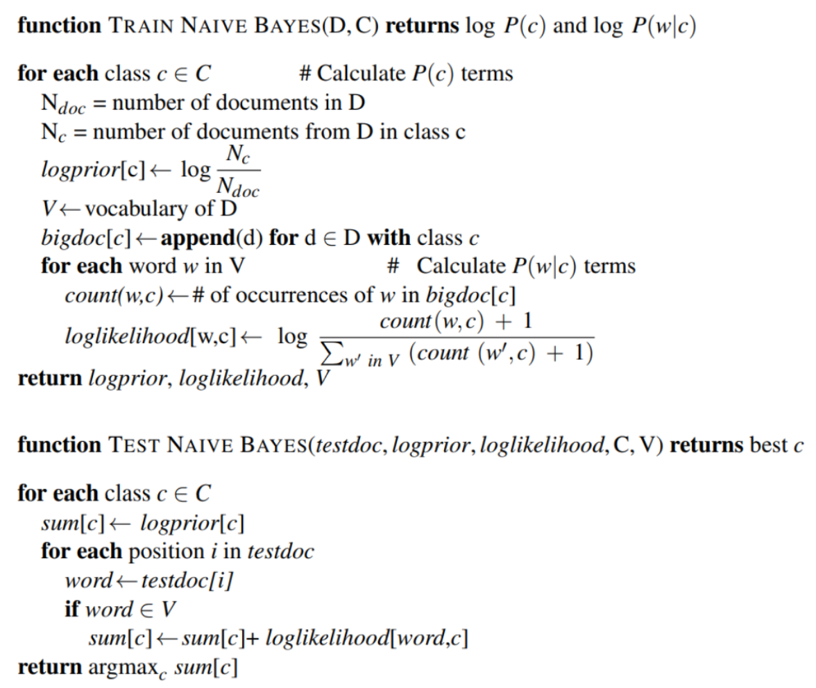
Naïve Bayes
Naive Bayes is a basic approach for building classifiers, which are models that give class labels to problem cases represented as vectors of feature values, with the class labels selected from a finite set.
We need to pick out some iconic words like “COVID-19”,“Coronvirus,’’no ”…
It aims to find out the probabilities of a specific word in different classes(true or false). We can use likelihood to calculate the semantics of this word(like it is positive or not), to predict the semantics of this document.
Then we could get the accuracy, recall, precision, F1 score by comparing the ratio of the predicted class and correct class.

Slide 8
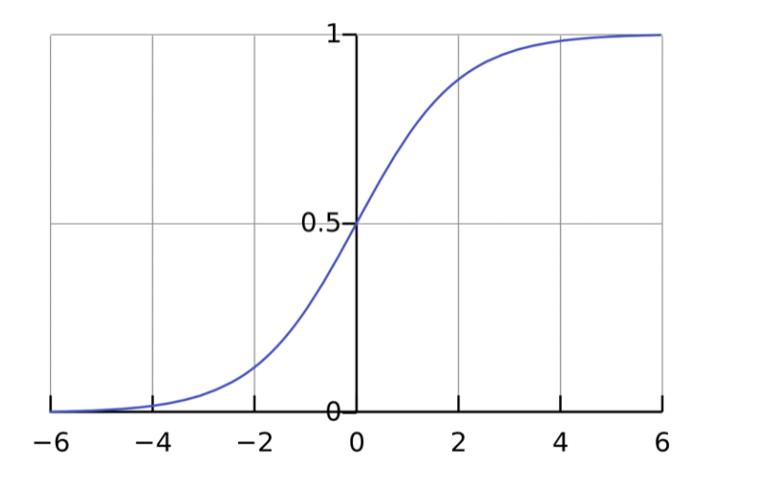
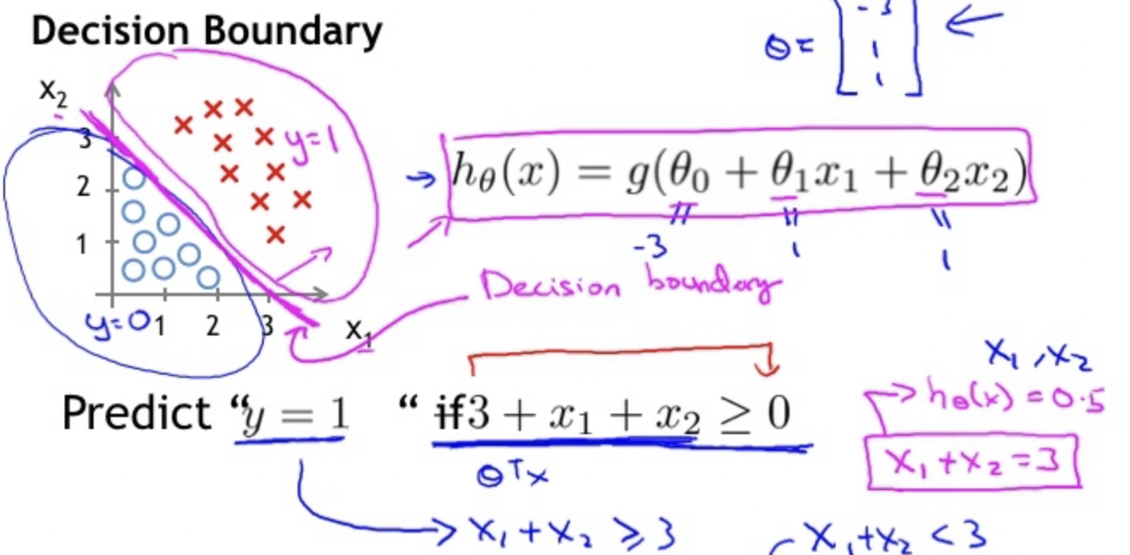
Logistic Regression (Binary classification)
In statistics, the logistic model (or logit model) is used to model the probability of a certain class or event existing such as pass/fail, win/lose, alive/dead or healthy/sick. This can be extended to model several classes of events such as determining whether an image contains a cat, dog, lion, etc. Each object being detected in the image would be assigned a probability between 0 and 1, with a sum of one.
Threshold of sigmoid is between 0 to 1

Slide 9
Conclusion and future work
In other works, some people claim that Naïve bayes has better
Performance than Logistic Regression in the small size dataset,
In our program, we find that Naïve Bayes is slightly better than
Logistic Regression.
In the future, we can try some other semantic model like
N-gram, to distinguish the content of the sentence.

